Slide 1
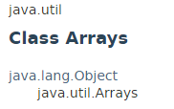
java.util.Arrays Introduction
Arrays class contains various methods for manipulating arrays (such as sorting and searching).
Arrays class also contains a static factory that allows arrays to be viewed as lists.

Slide 2
java.util.Arrays Introduction
https://docs.oracle.com/javase/8/docs/api/java/util/Arrays.html

